Slide 1
Week3
Summer2021
AI
Dr. Armin Chitizadeh

Slide 2
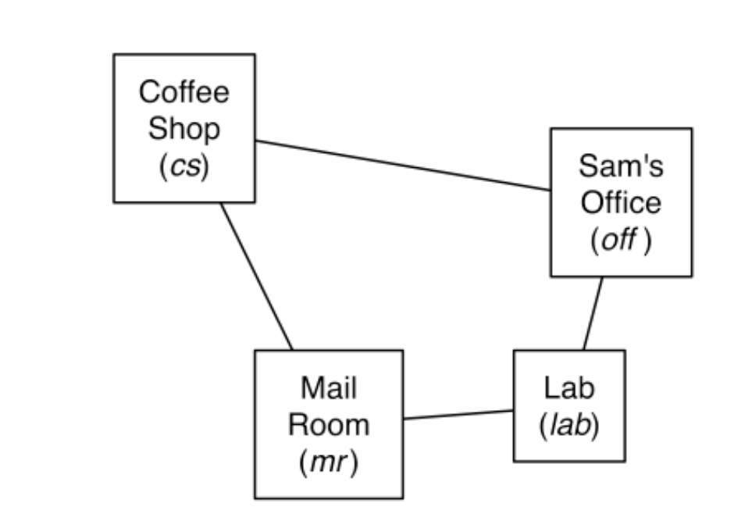
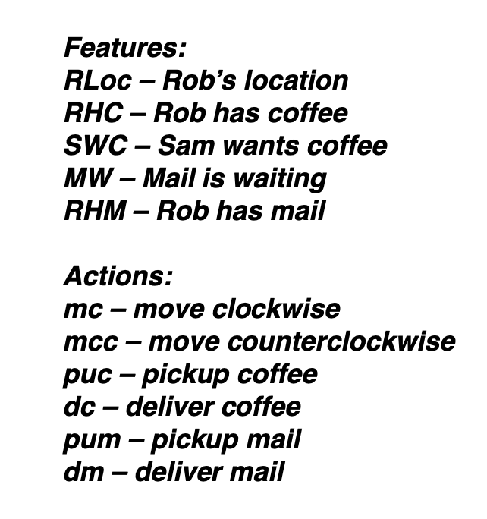
Activity 1.
Activity 1. Consider the planning problem from the lectures. (a) Give the STRIPS representations for the pick up mail (pum) and deliver mail (dm) actions.
The pickup mail action (pum) is defined using STRIPS by:
Preconditions: RLoc = mr ∧ mw
Effects: [¬mw, rhm]
The deliver mail action (dm) is defined using STRIPS by:
Preconditions: RLoc = off ∧ rhm
Effects: [¬rhm]

Slide 3
Activity 1.
Activity 1. Consider the planning problem from the lectures. (b) Give the feature-based representation of the MW and RHM features.
The MW feature can be axiomatised by defining when MW = true (written as mw):
mw’ ← mw ∧ Action ≠ pum
The RHM feature can be axiomatised by defining when RHM = true (written as rhm):
rhm’ ← Action = pum rhm’ ← rhm ∧ Action ≠ dm

Slide 4
Activity 2
Activity 2. Formulate the blocks world using STRIPS planning operators. The actions are stack (move one block to the top of another) and unstack (move one block to the table). The robot can hold only one block at a time.
To simplify the world, assume the only objects are the blocks and the table, and that the only relations are the on relation between (table and) blocks and the clear predicate on table and blocks. Also assume that it is not possible for more than one block to directly support another block (and vice versa).
stack(A,B):
Preconditions: clear(A) ∧ clear(B) Effects: on(A, B) ∧ ¬ clear(B)
A
B

Slide 5
Activity 2
Activity 2. Formulate the blocks world using STRIPS planning operators. The actions are stack (move one block to the top of another) and unstack (move one block to the table). The robot can hold only one block at a time.
To simplify the world, assume the only objects are the blocks and the table, and that the only relations are the on relation between (table and) blocks and the clear predicate on table and blocks. Also assume that it is not possible for more than one block to directly support another block (and vice versa).
unstack(A):
A
Preconditions: clear(A) ∧ on(A, B) Effects: on(A, Table) ∧ clear(B) ∧ ¬on(A, B)
B

Slide 6
PERT (II)

Slide 7
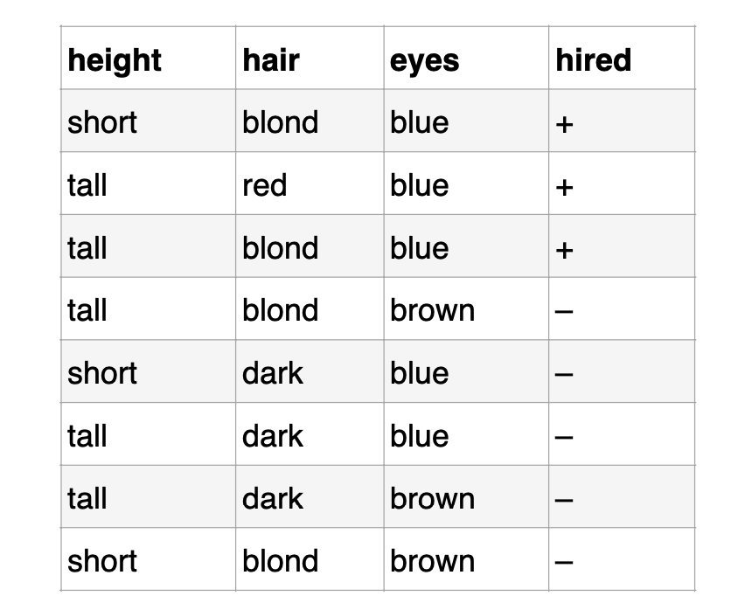
Activity 1
Consider the task of predicting whether children are likely to be hired to play members of the Von Trapp Family in a production of The Sound of Music, based on these data:
1) Compute the information (entropy) gain for each of the three attributes (height, hair, eyes) in terms of classifying objects as belonging to the class, + or – .
(2) Construct a decision tree based on the minimum entropy principle.
Height:
*There are 3 objects in class '+' and 5 in '-', so the entropy is:
Entropy(parent) = Σi Pi log2Pi = -(3/8)log(3/8) - (5/8)log(5/8) = 0.954
*The average entropy after splitting on 'height' is
Entropy(height) =
(3/8)(0.918) + (5/8)(0.971) = 0.951
*Of the 3 'short' items, 1 is '+' and 2 are '-', so:
Entropy(short) = -(1/3)log(1/3) - (2/3)log(2/3) = 0.918
*Of the 5 'tall' items, 2 are '+' and 3 are '-', so:
Entropy(tall) = -(2/5)log(2/5) - (3/5)log(3/5) = 0.971
The information gained by testing this attribute is:
0.954 - 0.951 = 0.003 (i.e. very little)

Slide 8
Your time :)

